Slide 1
Field report of botany
Topic : Medicinal plants found in locality
Submitted to:-
Prof. Manjeet kaur Manchanda
Ass. Prof. Pooja Verma
Submitted by:-
Diksha arora
B.Sc final yr.

Slide 2
Acknowledgement
The success and final outcome of this project required a lot of guidance and assistance from many people and I am extremely privileged to have got this all along the completion of my project. All that I have done is only due to such supervision and assistance and I would not forget to thank them.
I respect and thank Prof. Manjit Kaur Manchanda & Prof. Pooja Verma for providing me an opportunity to do the project work and giving us all support and guidance which made me complete the project duly. I am extremely thankful to them for providing such a nice support and guidance, although she had busy schedule managing the corporate affairs.
I owe my deep gratitude to my mates who took keen interest on our project work and guided us all along, till the completion of our project work by providing all the necessary information for developing a good system.
I am thankful to and fortunate enough to get constant encouragement, support and guidance from all which helped us in successfully completing our project work.

Slide 3
Medicinal Plants
Medicinal plants, also called medicinal herbs, are basically any plants which provides health promoting characteristics, temporary relief or symptomatic problems or curative properties. Drugs or preparations can be made from such plants and used to prevent and treat diseases and ailments or to promote health and healing.
Plants provide the predominant ingredients of medicines in most traditional systems of healing and have been the source of inspiration for several major pharmaceutical drugs.

Slide 4
Traditional use
Medicinal plants had been used by all cultures throughout history. It was an integral part of the development of human civilization. Much of the medicinal use of plants seems to have been developed through observations of wild animals and by trial and error. As time went on, each tribe added the medicinal power of herbs in their area to its knowledge.

Slide 5
Medicinal plants found in near locality
Sr.no | Botanical name | Common name
1 | Aloe barbadensis | Aloe Vera
2 | Phyllanthus emblica | Amla
3 | Cassia fistula | Amaltas
4 | Musa paradisiaca | Banana
5 | Bryophyllum pinnatum | Bryophyllum
6 | Psidium guajava | Guava
7 | Mangifera indica | Mango
8 | Azadirachta indica | Neem
9 | Ocimum sanctum | Tulsi
10 | Calendula officinalis | Calendula

Slide 6
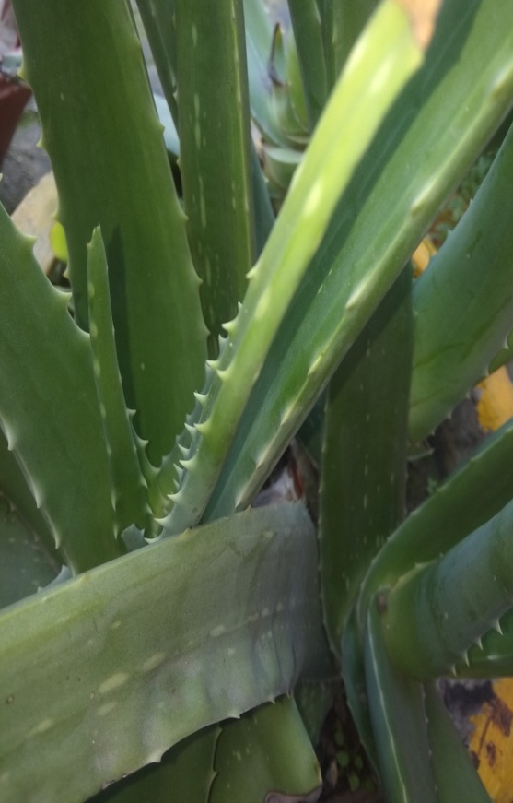
Aloe Vera-Aloe barbadensis
Aloe Vera is a succulent very short-stemmed plant growing to 60–100 cm (24–39 in) tall. The leaves are thick and fleshy, green to grey-green
Chemical composition:
Contains vitamins, sugars, lignin, saponins, salicylic acids, anthrones, glycosides,polymannans,
Anthraquinone
Medicinal Uses:
It is said to enhance insulin sensitivity and help improve blood sugar management.
Early evidence suggests that Aloe Vera may have anti-aging effects on the skin.
Aloe Vera latex has strong laxative effects, making it useful to treat constipation. It does not appear to be beneficial for other diseases of the digestive tract such IBD and IBS
Aloevera leaves
Family Asphodelaceae

Slide 7
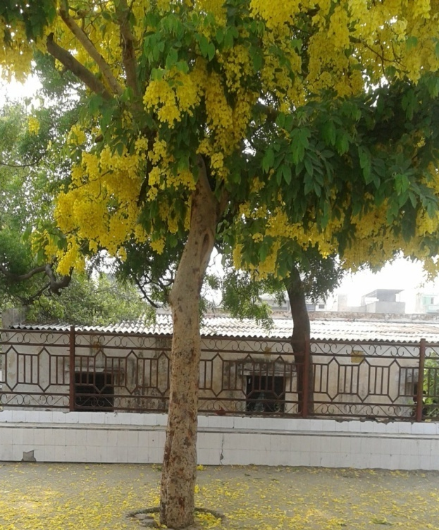
Amaltas-Cassia fistula
A medium sized semi-deciduous tree, with a straight trunk.The stem bark is dark brown. The leaves are alternate, spirally arranged. The showy flowers bright yellow in colour
Chemical composition:
Leaves contains Oxalic Acids, Tannins, Oxyanthra-quinones, Anthraquinones derivatives. Fruit contains Fistulic Acids, Sennosides A B, Anthraquinones, and Flavanoid-3-ol-derivatives. Ceryl Alcohol,
Kaempferol, Bianthraquinone
Medicinal Uses:
Aqueous extract of flowers was screened for its antioxidant effect in alloxan induced cases
Hexane extract from the fruits showed significant antileishmanial activity
Methanolic extract of seed showed a decrease in the tumor volume and viable tumor cell count
The methanolic extract of leaves was examined for its wound healing property in the form of an ointment
Amaltas tree
Family Fabaceae

Slide 8
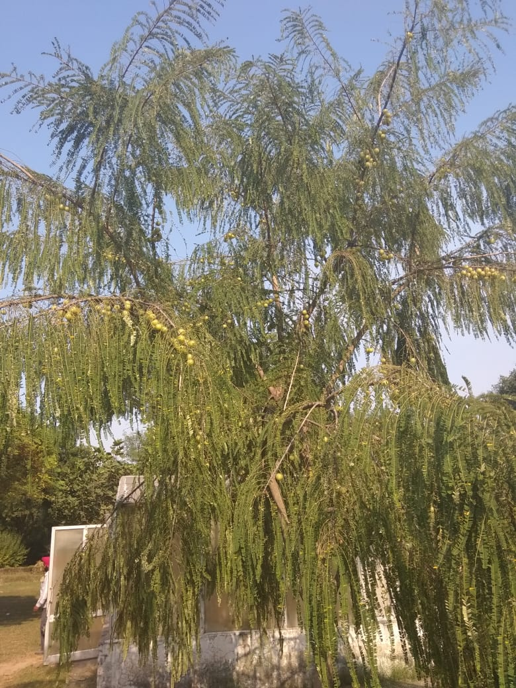
Amla-Phyllanthus emblica
It is a tree of moderate size with a greenish-grey bark and greenish-yellow flowers, formed in clusters. The feathery leaves are linear-oblong, light green and resembling pinnate leaves. Fruits are about 1.5-2.5 cm
Chemical composition:
Contains high amounts of ascorbic acid (vitamin C), and high density of ellagitannins such as emblicanin A & B,
punigluconin and pedunculagin and considerably higher concentrations of Glutamic acid, proline, aspartic acid,
alanine, cystine and lysine
Medicinal Uses:
Emblica was shown to reduce UV-induced erythema
It removes excessive salivation and internal body heat
Amla Tonic has a hematinic and lipalytic function useful in scurvy, prevents indigestion, and controls acidity as well as it is a natural source of anti-aging.
Amla tree
Family Phyllanthus

Slide 9
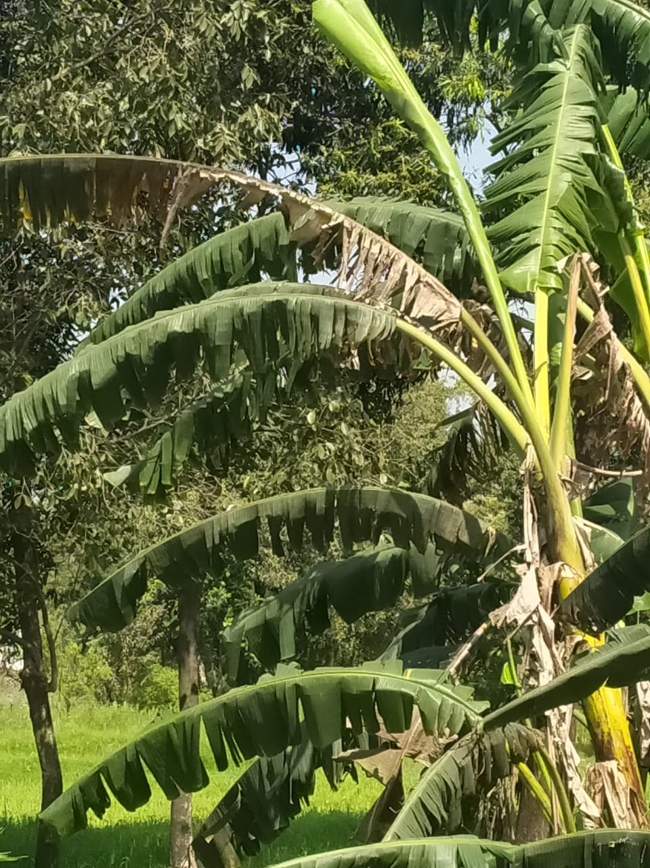
Banana -Musa paradisiaca
The banana plant is the largest herbaceous flowering plant. They are normally tall and fairly sturdy, but what appears to be a trunk is actually a pseudostem. Leaves are spirally arranged.
Chemical composition:
Contains Potassium (K),Vitamin B6,Vitamin C, Isoamyl acetate, Pectin.Also contains contents of cellulose, starch, lignin, fructooligosaccharide and lipophilic extractives.
Medicinal Uses:
Flowers: Used to treat dysentery, ulcers, and bronchitis.
Sap: Chemically, banana sap has astringent qualities.used to leprosy, hysteria, fever, digestive disorders, hemorrhage, epilepsy, hemorrhoids, and insect bites.
Roots and Seeds: Treat digestive disorders.
Peel and Pulp: Contains neurotransmitters norepinephrine, serotonin and dopamine.
Banana tree
Family Musaceae

Slide 10
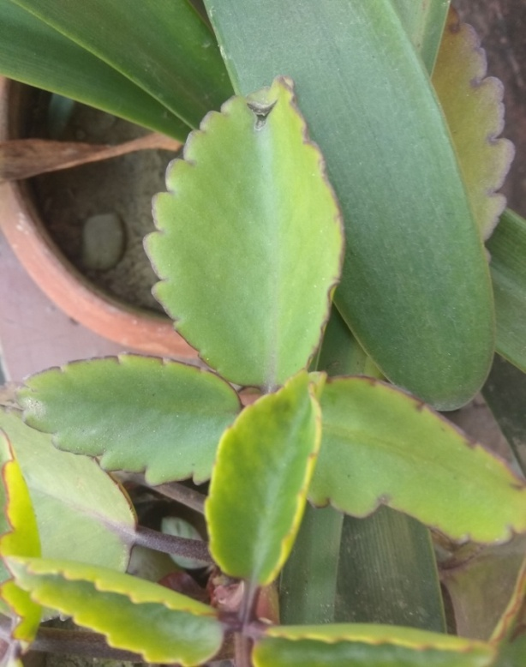
Bryophyllum - Bryophyllum pinnatum
A succulent glabrous herb 0.3-1.2 m high. Stems obtusely four angled, older one are light coloured & younger ones are reddish speckled with white.
Chemical composition:
Contains bryophyllin-A, two flavonoids i.e. 5’ Methyl 4’,5,7 trihydroxyl flavone and 4’,3,5,7 tetrahydroxy 5-methyl 5’-propenamine anthocyanidines
Medicinal Uses:
Leaves extracts have varied antibacterial activities.
They have presence of growth inhibitory activity in the human cervical cancer cells.
There is presence of antilithogenic activity of fresh leaf juice.
The aqueous and ethanolic extract in the doses slightly protect the liver.
It is significantly better tolerated in the management of preterm labour
Bryophyllum leaves
Family
Crassulaceae

Slide 11
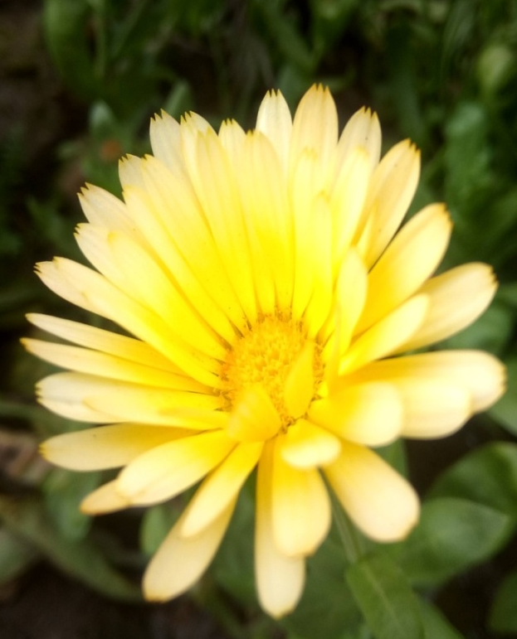
Calendula- Calendula officinalis
A short-lived aromatic herbaceous perennial, growing to 80 cm tall, with erect stems. Leaves long, hairy margins. Inflorescence yellow
Chemical composition:
The petals contain triterpenoid esters and flavoxanthin and auroxanthin. The leaves and
stems contain mostly lutein (80%), zeaxanthin
(5%), and beta-carotene.
Medicinal Uses:
Calendula is a wonderful herb recommended for GERD which affects people with the symptoms of heartburn.
Used to treat acute or chronically swollen lymph nodes resulting from respiratory infections.
It is also used to build immunity by helping to prevent infection through activation of the lymphatic system.
Calendula flower
Family
Asteraceae

Slide 12
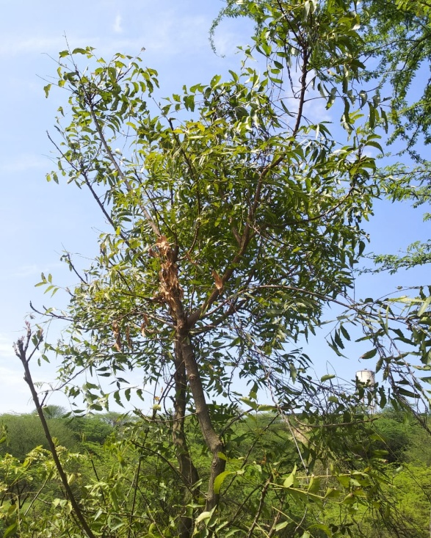
Neem -Azadirachta indica
A medium-sized tree mainly evergreen. Bark grey. Branches are numerous and spreading. Leaves alternate. The white flowers are numerous
Chemical composition:
They mainly yield quercetin (flavonoid) and nimbosterol as
well as number of liminoids. The bark contains nimbin,
nimbinin, nimbidin etc.
Medicinal Uses:
The plant possessing anti-bacterial, anti-viral, cytotoxic, fungicidal, insecticidal or pesticidal properties.
External medicinal uses of neem is for the treatment of dermatological disorders like ear infection and sinusitis,
alopecia and hair care, snake bite and scorpion sting,
rheumatic pain, gout, etc.
Internally neem is used for dental hygiene, for treating
malaria and filaria, typhoid, liver disorders, intestinal worms, hepatitis, respiratory disorders, urinary disorders, diabetes, hypertension, cancer, leprosy, leucoderma, allergies, etc., infectious diseases such as smallpox, chicken pox, and measles,sexually transmitted infection, and aids.
In Vedas Neem is mentioned as ‘Sarva Roga Nivarini’, which means ‘one that cures all ailments and ills‘
Neem tree
Family
Meliaceae

Slide 13
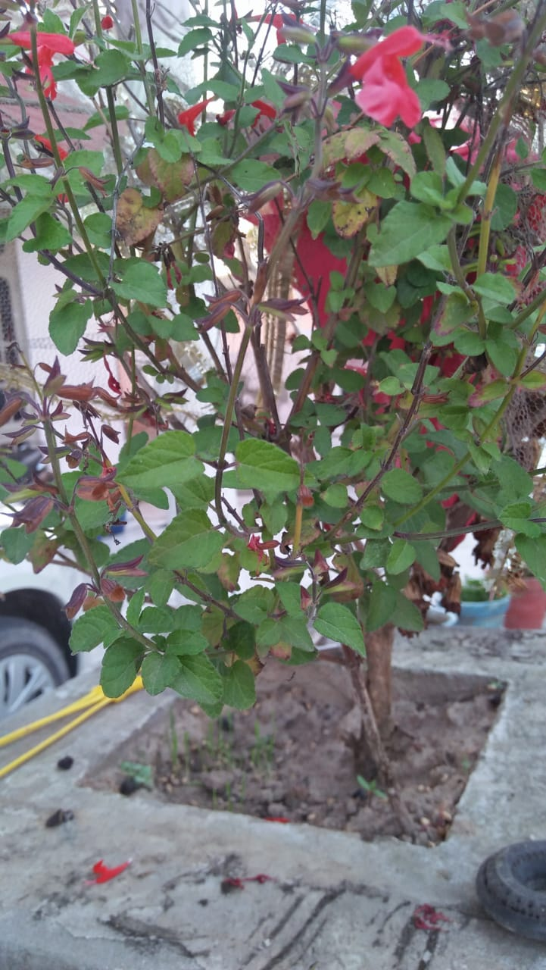
Tulsi -Ocimum sanctum
It is an erect & fragrant herb having hair all over. Leaves are nearly round with margin toothed these are aromatic because of the presence of a kind of scanted oil.
Chemical composition:
Contains cirsilineol, circimaritin, isothymusin, apigenin and rosameric acid. The leaves contain about 71% eugenol and 20% methyl eugenol. The oil also contains carvacrol and sesquiterpine hydrocarbon caryophyllen.
Medicinal Uses:
The Tulsi leaves contains ursolic acid which possess antifertility effects it have anti-estrogenic activity.
Extract of leaves mediated a significant reduction in tumor cell size and an increase in lifespan of mice having Sarcoma-180 solid tumors.
Vitamin C and A, phytonutrients, in Basil are great antioxidants and protect the skin from almost all the damages caused by free radicals.
It also helps in relieving fever mild headaches because of migrane cure various respiratory disorders like bronchitis & tuberculosis.
Tulsi plant
Family
Lamiaceae

Slide 14
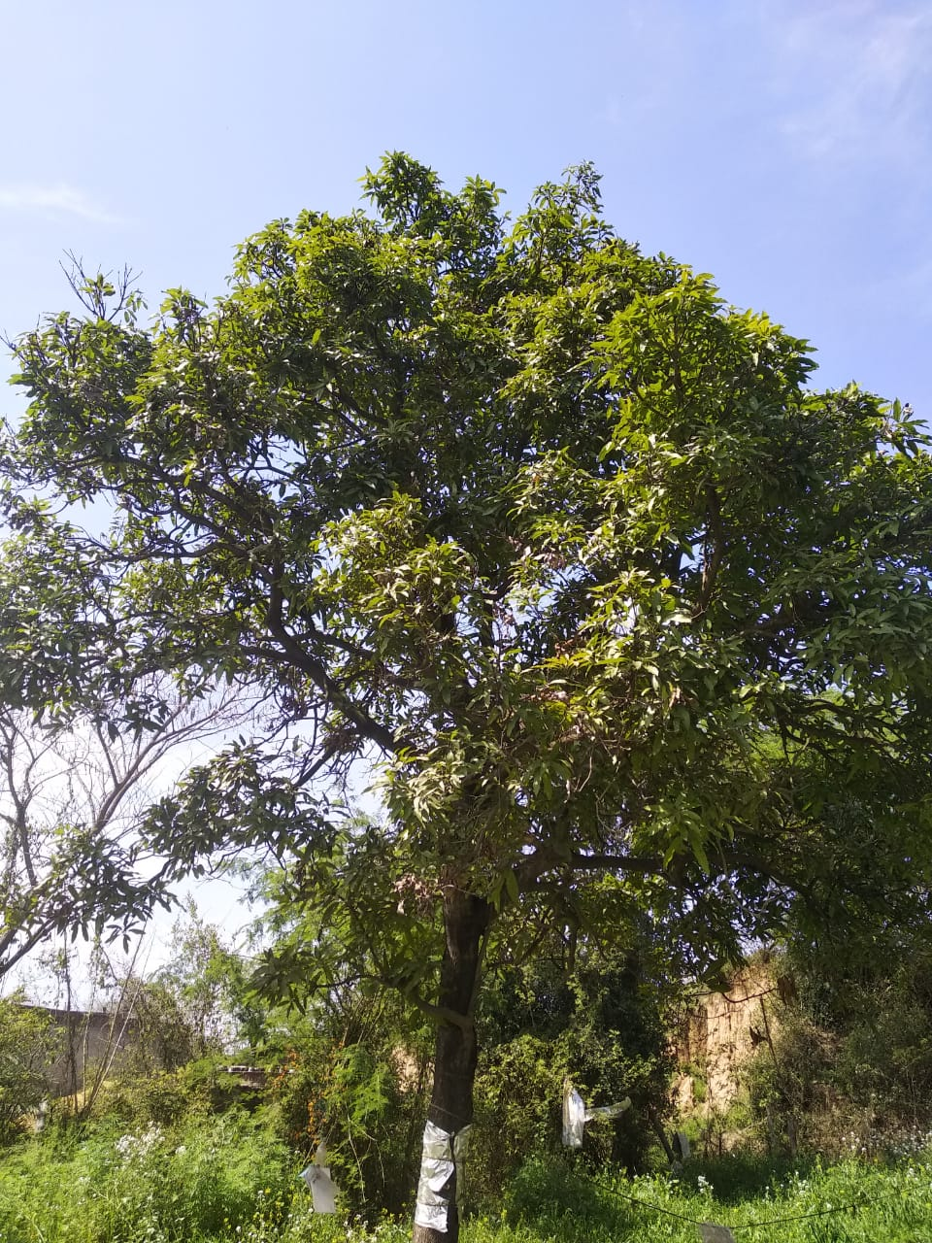
Mango -Mangifera indica
The mango tree is an evergreen tree of varying size and shape. A stout trunk and an umbrella-shaped crown that may reach 20-40 m high. The leaves are simple & broad. Flowers are fragrant, pentameric
Chemical composition:
Mango peel pigments include carotenoids, such as the provitamin A compound, beta-carotene, lutein and alpha-carotene, and polyphenols, such as quercetin, kaempferol, gallic acid, caffeic acid, tannins. Mango contains a unique xanthonoid called mangiferin. Also contain pigment euxanthin.
Medicinal Uses:
Mangoes contain antioxidants which protect our body against breast cancer, colon cancer, prostate cancer and leukaemia.
Mango has a low glycemic index; eating mango in moderation will not increase your blood sugar level.
Mango bark has an astringent properties which is used to regulate rashes on skin.
Flowers of mango can be used as a natural blood purifier and is also useful in IBS, diarrhea & anorexia.
Mango tree
Family
Anacardiaceae

Slide 15
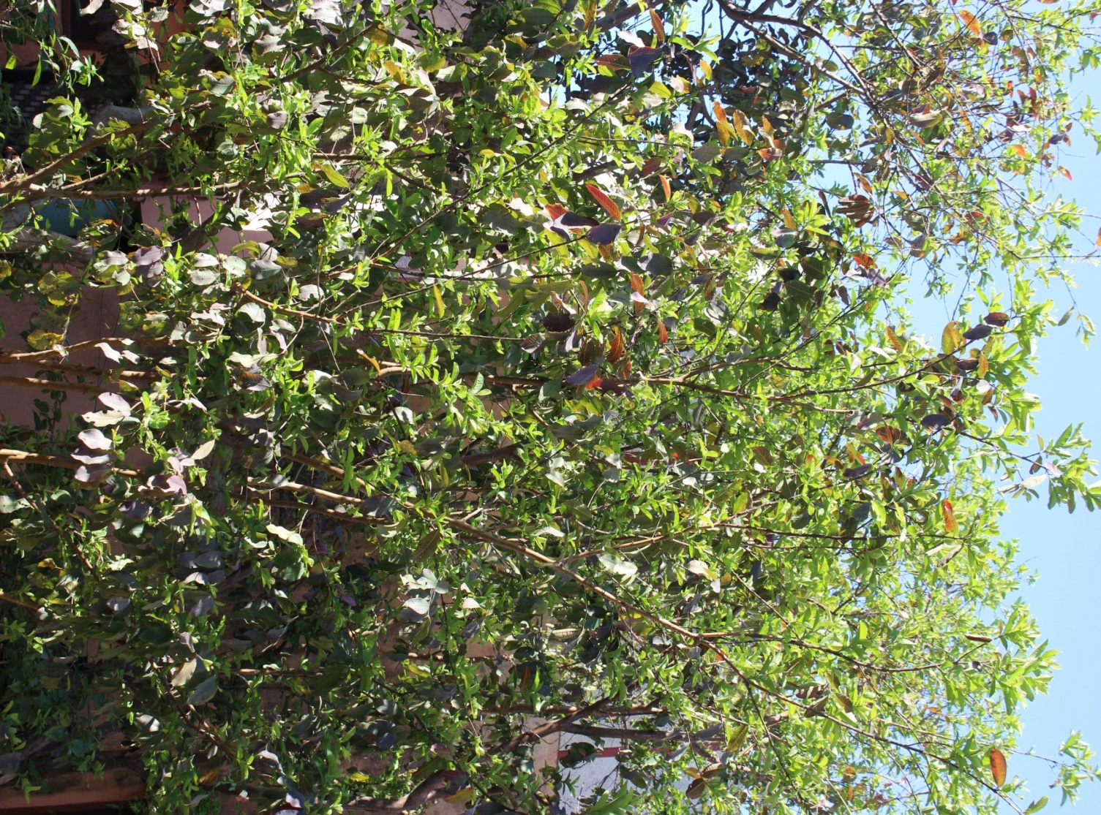
Guava-Psidium guajava
Guava is a fast growing evergreen tree. It has a shallow root system. The trunk is slender The leaves grow in pairs, opposite each other.The flowers are white in colour.
Chemical composition:
The guava fruit contains vitamin A, C, iron, phosphorus and calcium. Also the fruit contains saponin, oleanolic acid, lyxopyranoside, arabopyranoside, guaijavarin, quercetin and flavonoids . Ascorbic acid and citric acid
Medicinal Uses:
Guava has a high antimicrobial activity. Guava leaf’s extract and bark methanolic extracts doses can reduce the amount of cough due to its anti-cough activity.
Guava has high cytotoxicity. Guava can be used to treat the diarrhea caused by the E. coli.
Guava possesses anti-viral, anti-inflammatory, anti-plaque, antinociceptive activity and anti-mutagenic activities.
Guava tree
Family
Myrtaceae

Slide 16
Bibliography
Book
Plant that heals” by Dr. Jckurian
Further details are referred from
Google.com
Various details of medicinal plants are taken directly from the respective sites related to medicines and their recent studies news.
anniesremedy.com
healthveins.com
plantsjournal.com

